Slide 1



SENTIMENT ANALYSIS OF COVID19 Vaccination TWEETS
Team Name: HealthSense
Challenge – NLP
the Frontier of ADVANCED TECHNOLOGY IN Health Care

Slide 2
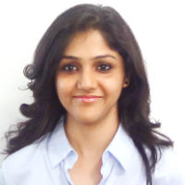
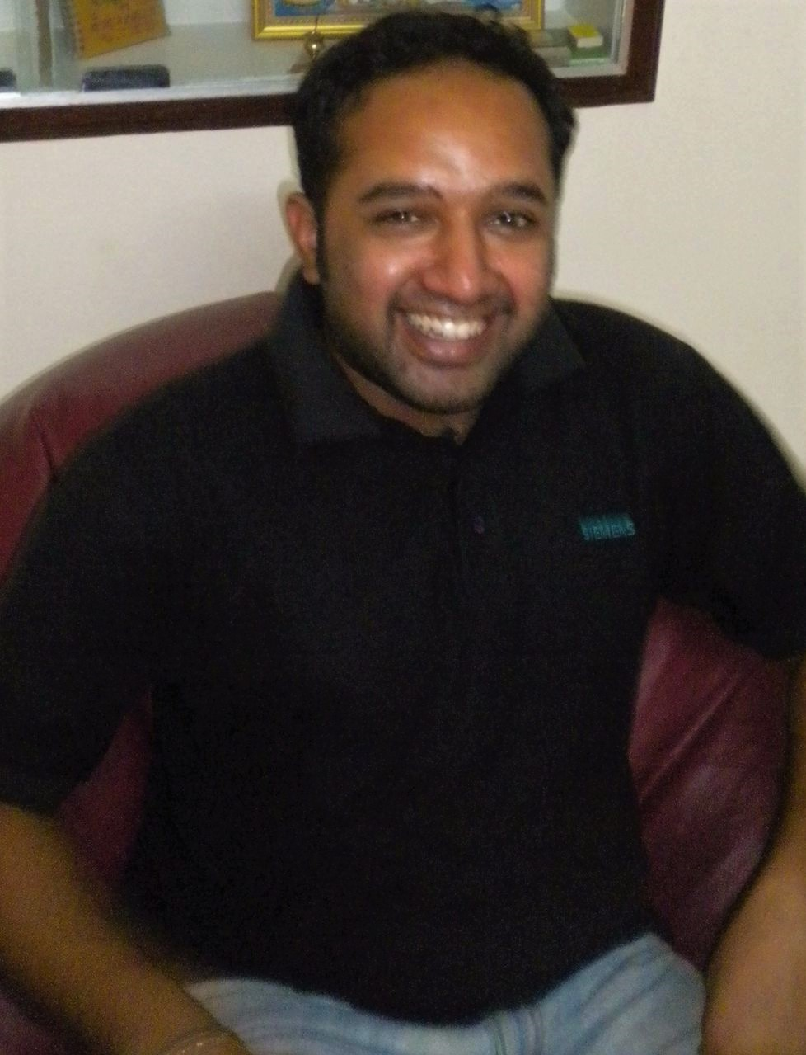
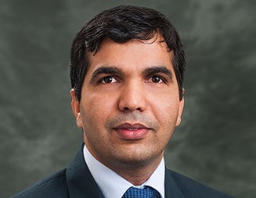
Team Member Profiles
Priyamvada
Gupta
Campaign Operations, OH & Optum Care Mkt Analytics and Data Science, Competitive Intelligence
Experience
11 years of total experience in Data science and Data Analytics. In Optum from last 1.8 years, previously worked with Genpact, dunnhumby and Zomato in risk, marketing and personalization.
Education
M.A.( Economics) – Delhi School of Economics
Vikalp Suhag
Optum Health and Optum Care Marketing Analytics engagement. MDX Data Intelligence and Analytics . MDX functional groups like AES, DEC and Campaign Management.
Experience
15+ years of experience in Healthcare, Financial Services and Printing Technology industries. Joined UHG in December 2014. In his prior roles within the organization, he has managed Advocate4Me (Real-Time Offer), NPS, Insurance Solutions and M&R Marketing Analytics.
Education
Computer Science Engineer
Pic
Pic
Pic
Pritish Pandey
Optum Health, Optum Care
Experience
6 years of total experience in Data science and Data Analytics. In Optum from last 4 months, previously worked with startups Minetell, Intello Transpo in consulting, IOT based products.
Education
B.Tech.( Electrical Engineering) – UPTU
Data Science Manager
Associate Data Analyst
Senior Manager Data Analytics

Slide 3
Solution Model
Vaccination Tweets
Data Cleaning
Feature Extraction
Sentiment Analyzer Engine
Training Split
Supervised Learning Engine for multi class classification
Multi Class Classification (Positive, Negative, Neutral)
Test Split
Trained Model for multi class prediction
Test classified across predicted classes
Short Description of How Your Solution Works – [AI and ML, NLP, AR and VR, IoT, Genomics, Graph, Cognitive, Quantum and Parallel Compute]

Slide 4
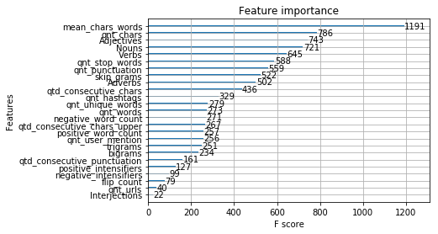
Results
Metrics | SVM | GBM | XGB | RF
Accuracy | 96.389% | 96.674% | 96.667% | 96.665%
Precision | 0.96 | 0.97 | 0.97 | 0.97
Recall | 0.96 | 0.97 | 0.97 | 0.97
* Train:test split @ 70:30
All 4 models performed well, GBM model being the most accurate.
This solution model with a few variations can be used with below cases:
To identify the sentiments of feedbacks/calls(speech to text) made to existing and potential clients.
With insurance sales data, the analysis can be used to predict if a call with a prospect would convert into a sale or not.

